Slide 1
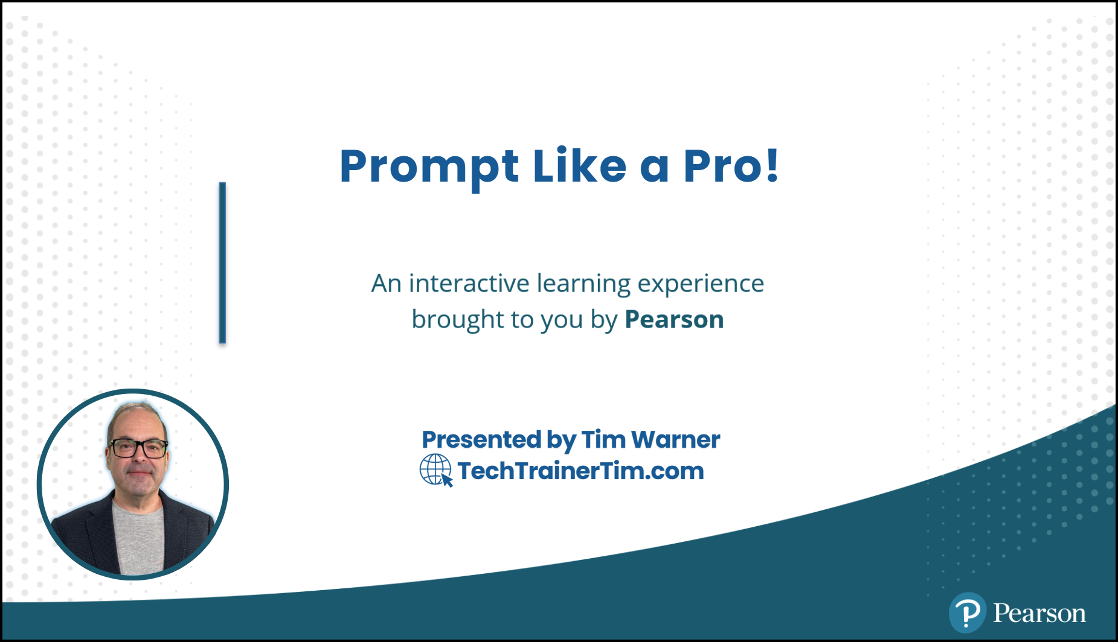
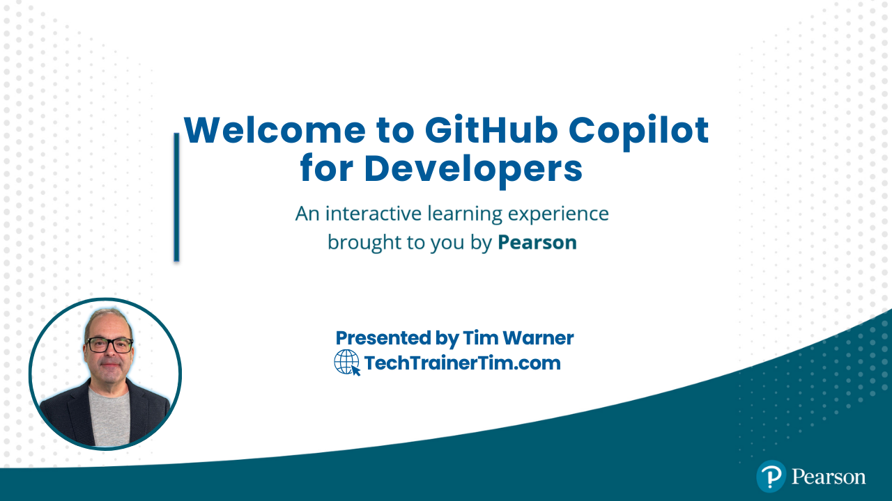



GitHub Copilot for Developers
Tim Warner
Principal Author, Pluralsight
timw.info | azureopenai.blog

Slide 2
Session Materials
timw.info/promptpro

Slide 3
Break Schedule (Central time)
09:00 AM - Start – Segment 1 [Get Started]
10:00 AM - Break (10 min) – Segment 2 [Everyday Dev]
11:00 AM - Break (10 min) – Segment 3 [Adv Features]
12:00 PM - Break 3 (10 min) – Segment 4 [Ecosystem + Future]
01:00 PM - Finish

Slide 4
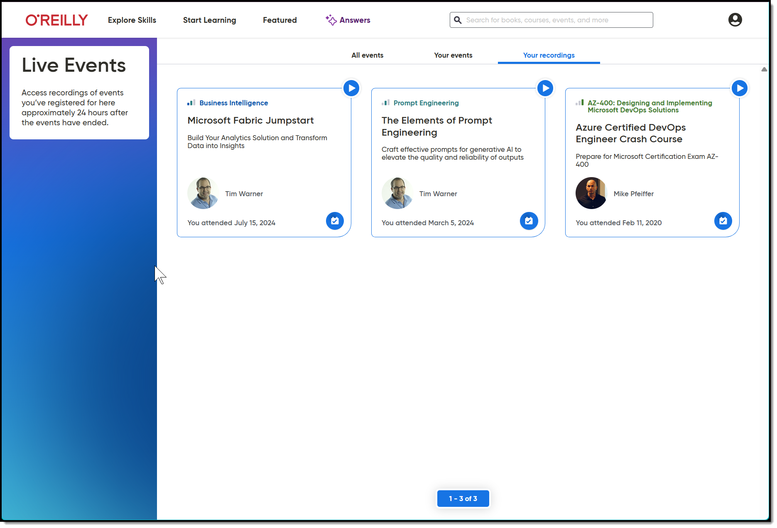
Session Recording + Badge

Slide 5
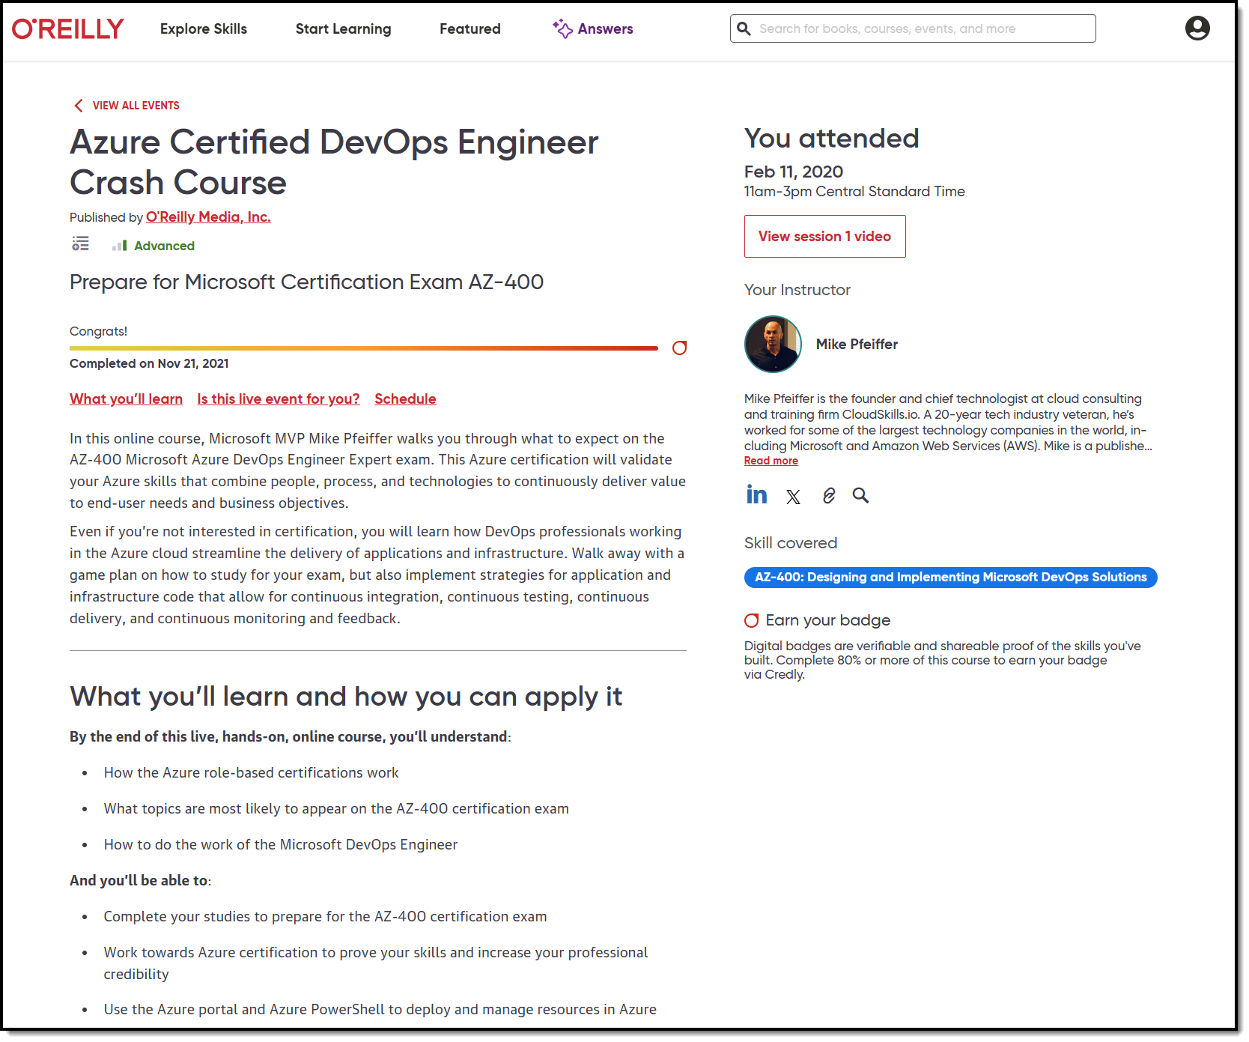
Session Recording + Badge

Slide 6
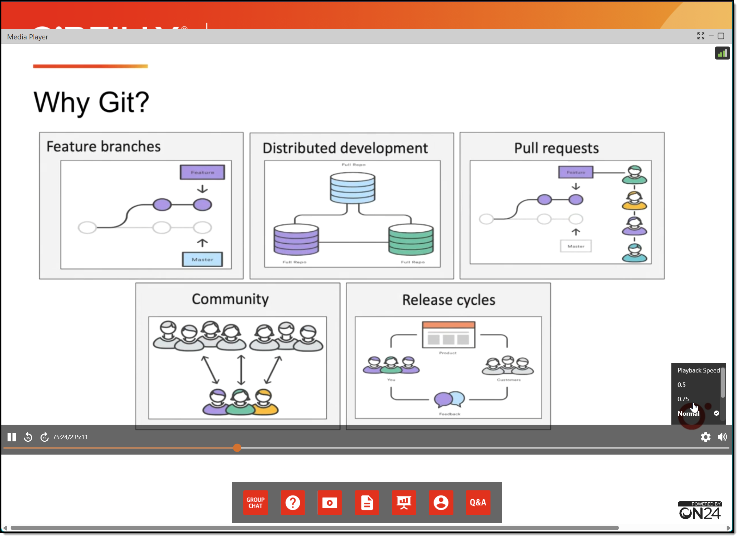
Session Recording + Badge

Slide 7
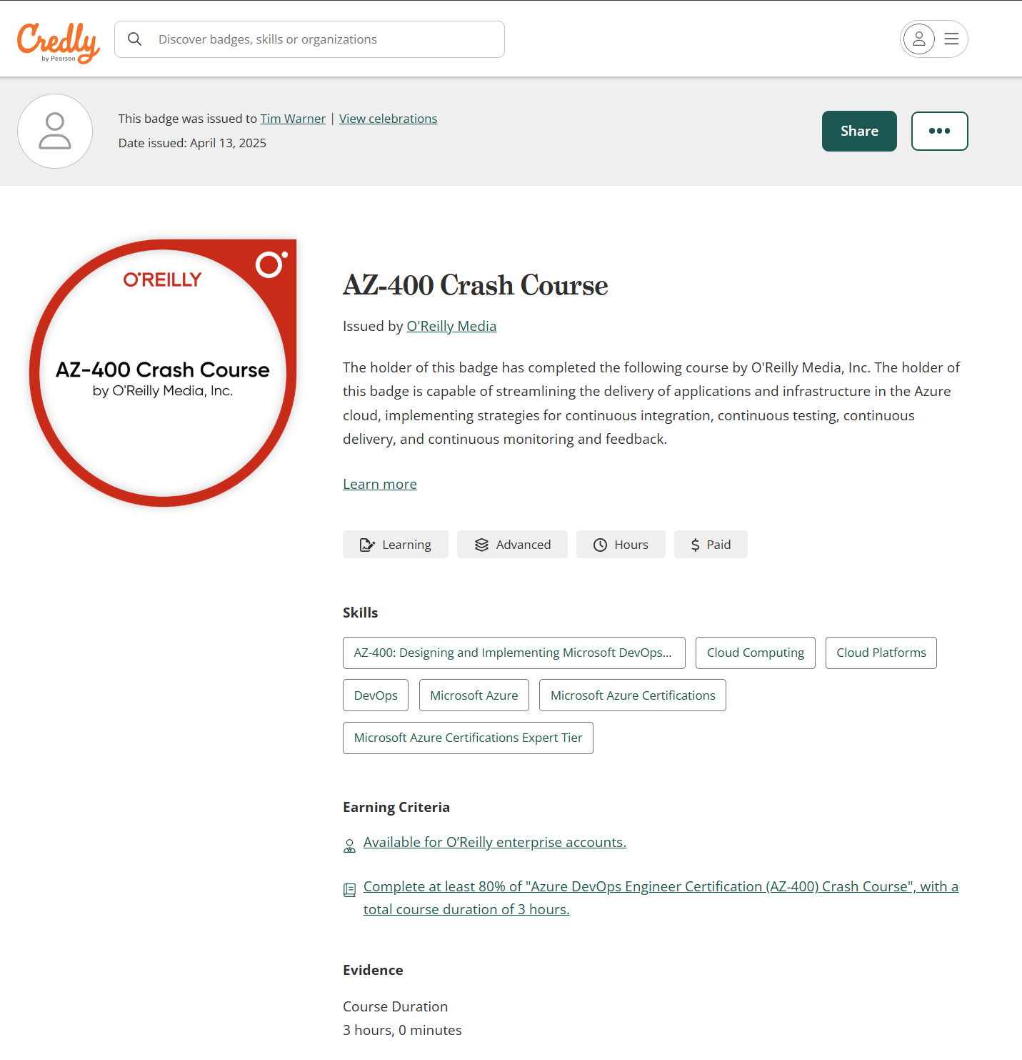
Session Recording + Badge

Slide 8
Let’s Get to Work!

Slide 9

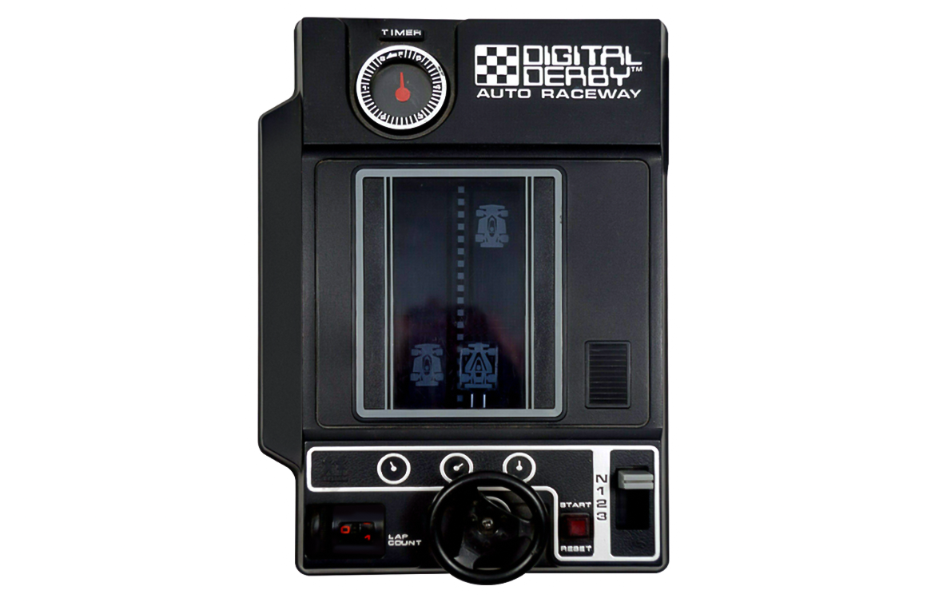
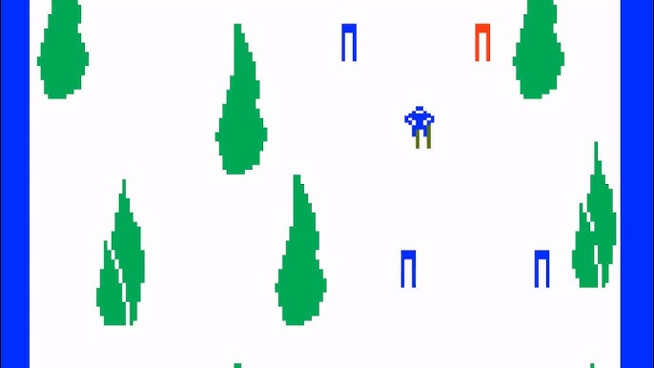
Keeping an LLM on task be like…

Slide 10
Wrap-up

Slide 11
Tim’s 2025 Generative AI Forecast
Listen to Sam Altman’s January speech on Operator
Agentic AI
Giving the LLM additional permissions to act autonomously
Multi-source notebook LLMs (Google Notebook LM)
Developers will show themselves by their skills
Reread <<

Slide 12
Tim’s Own Future of Software Development
Directing code generation rather than writing
We’ll (likely) always have a human-in-the-middle somewhere
Instruct the AI to teach YOU how to do the work yourself
Always know your auth context with LLMs
Master GitHub API and use VS Code
Stay grounded in Responsible AI principles

Slide 13
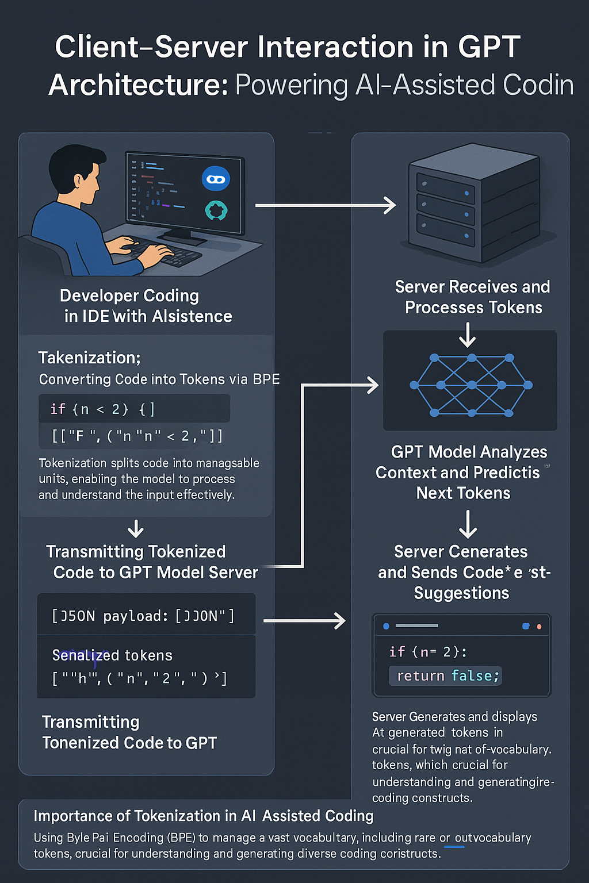
GPT Basic Architecture
OpenAI GPT 4o Image Generation
Multimodal generative AI
Two ways to improve model:
Fine tuning
Retrieval Augmented Generation (RAG)

Slide 14

Neural Network
go.techtrainertim.com/cloud

Slide 15

Context Length

Slide 16
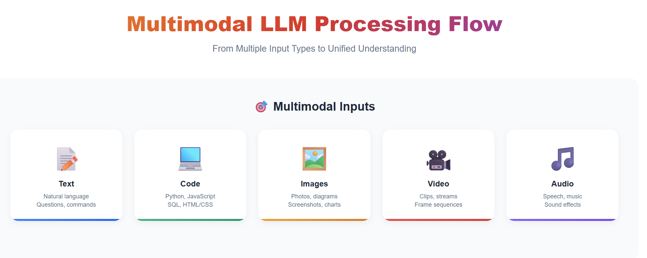
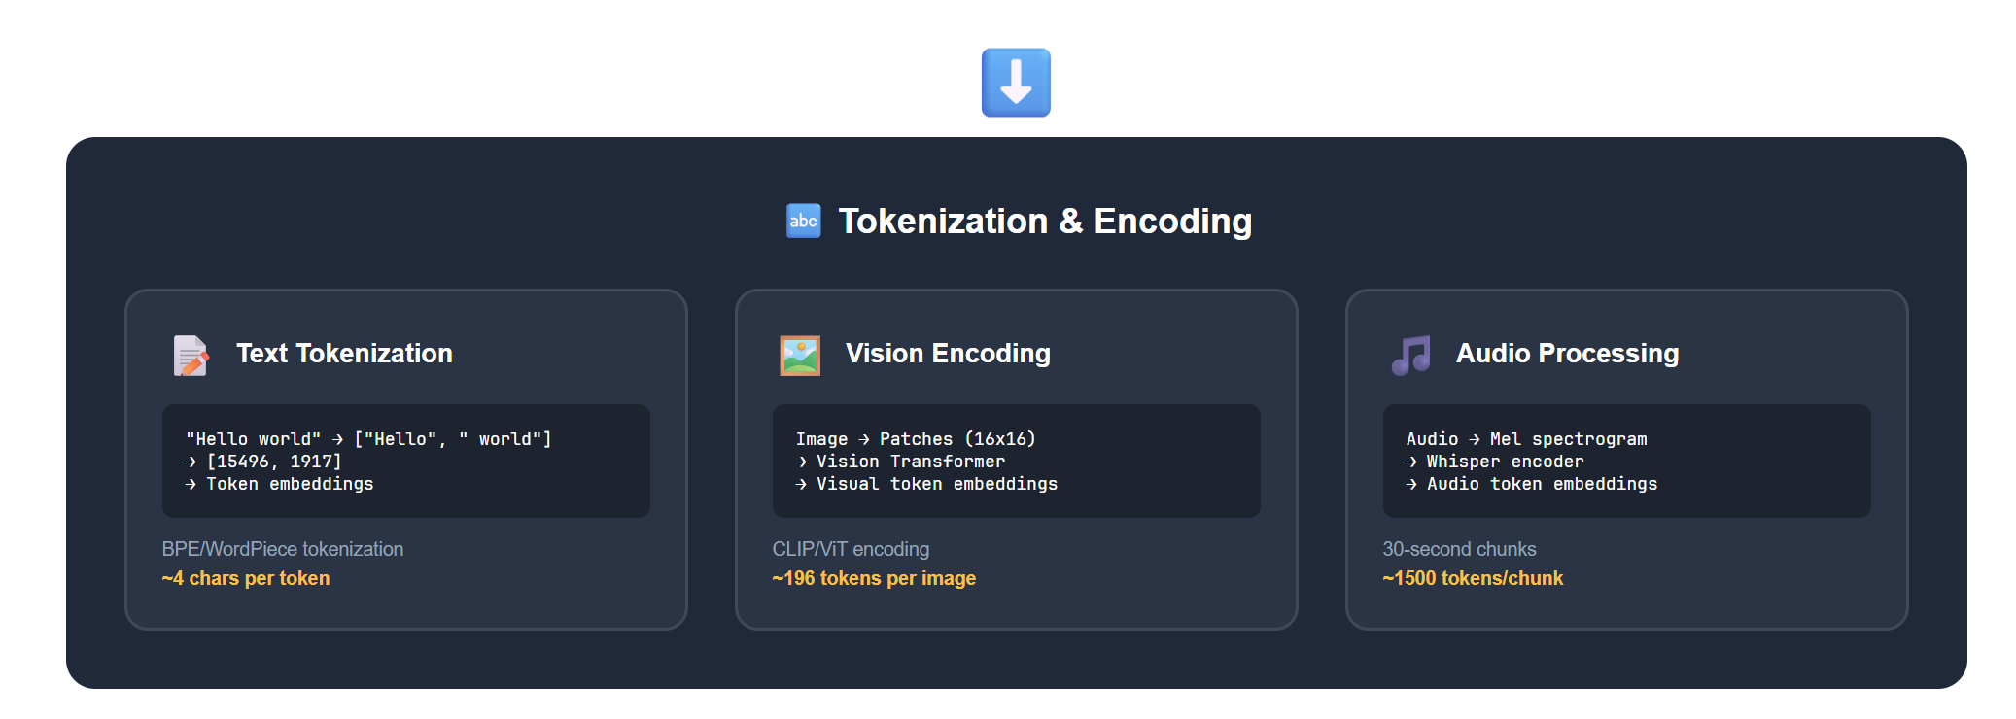
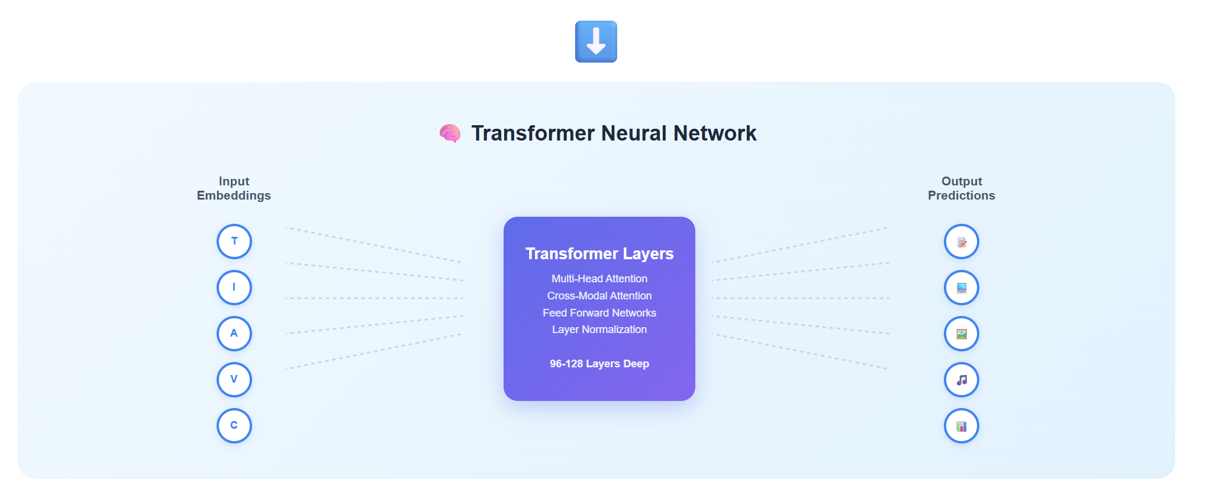
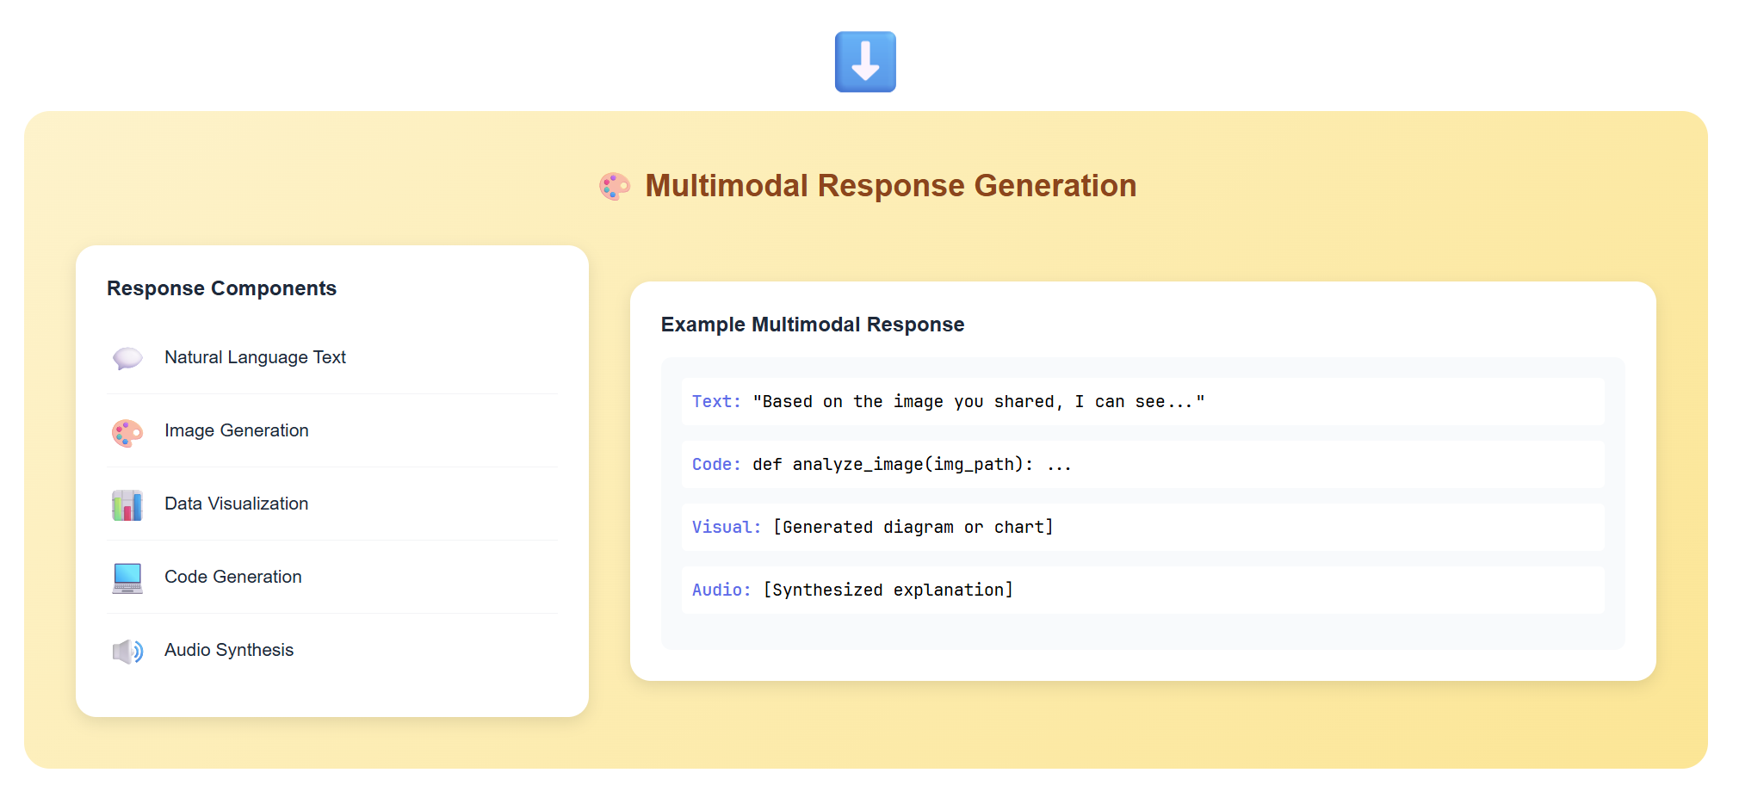

Slide 17
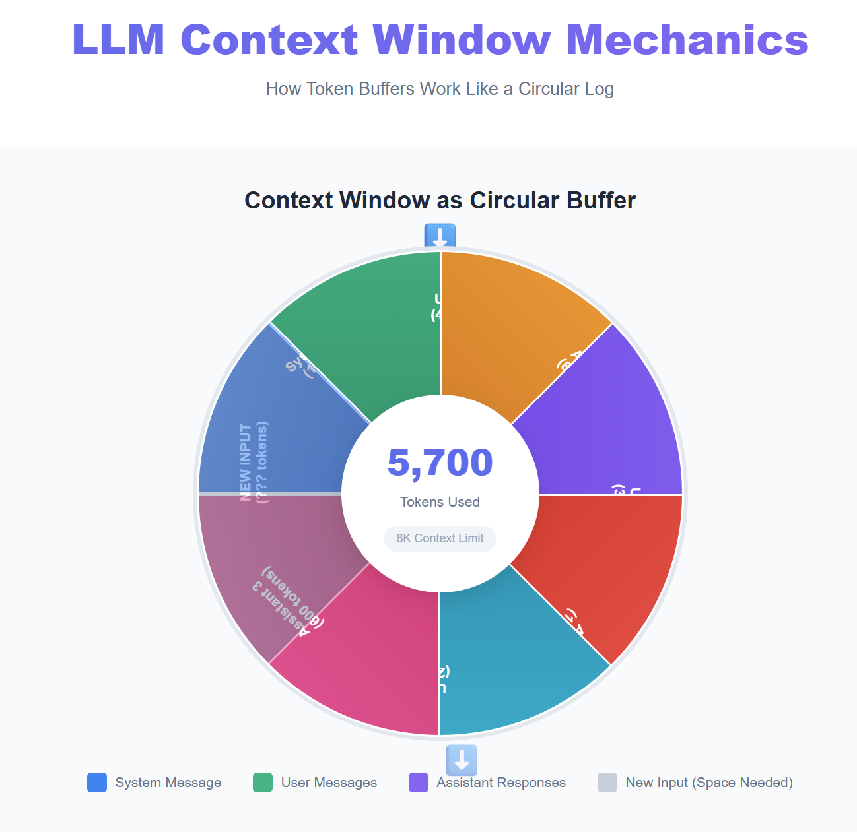
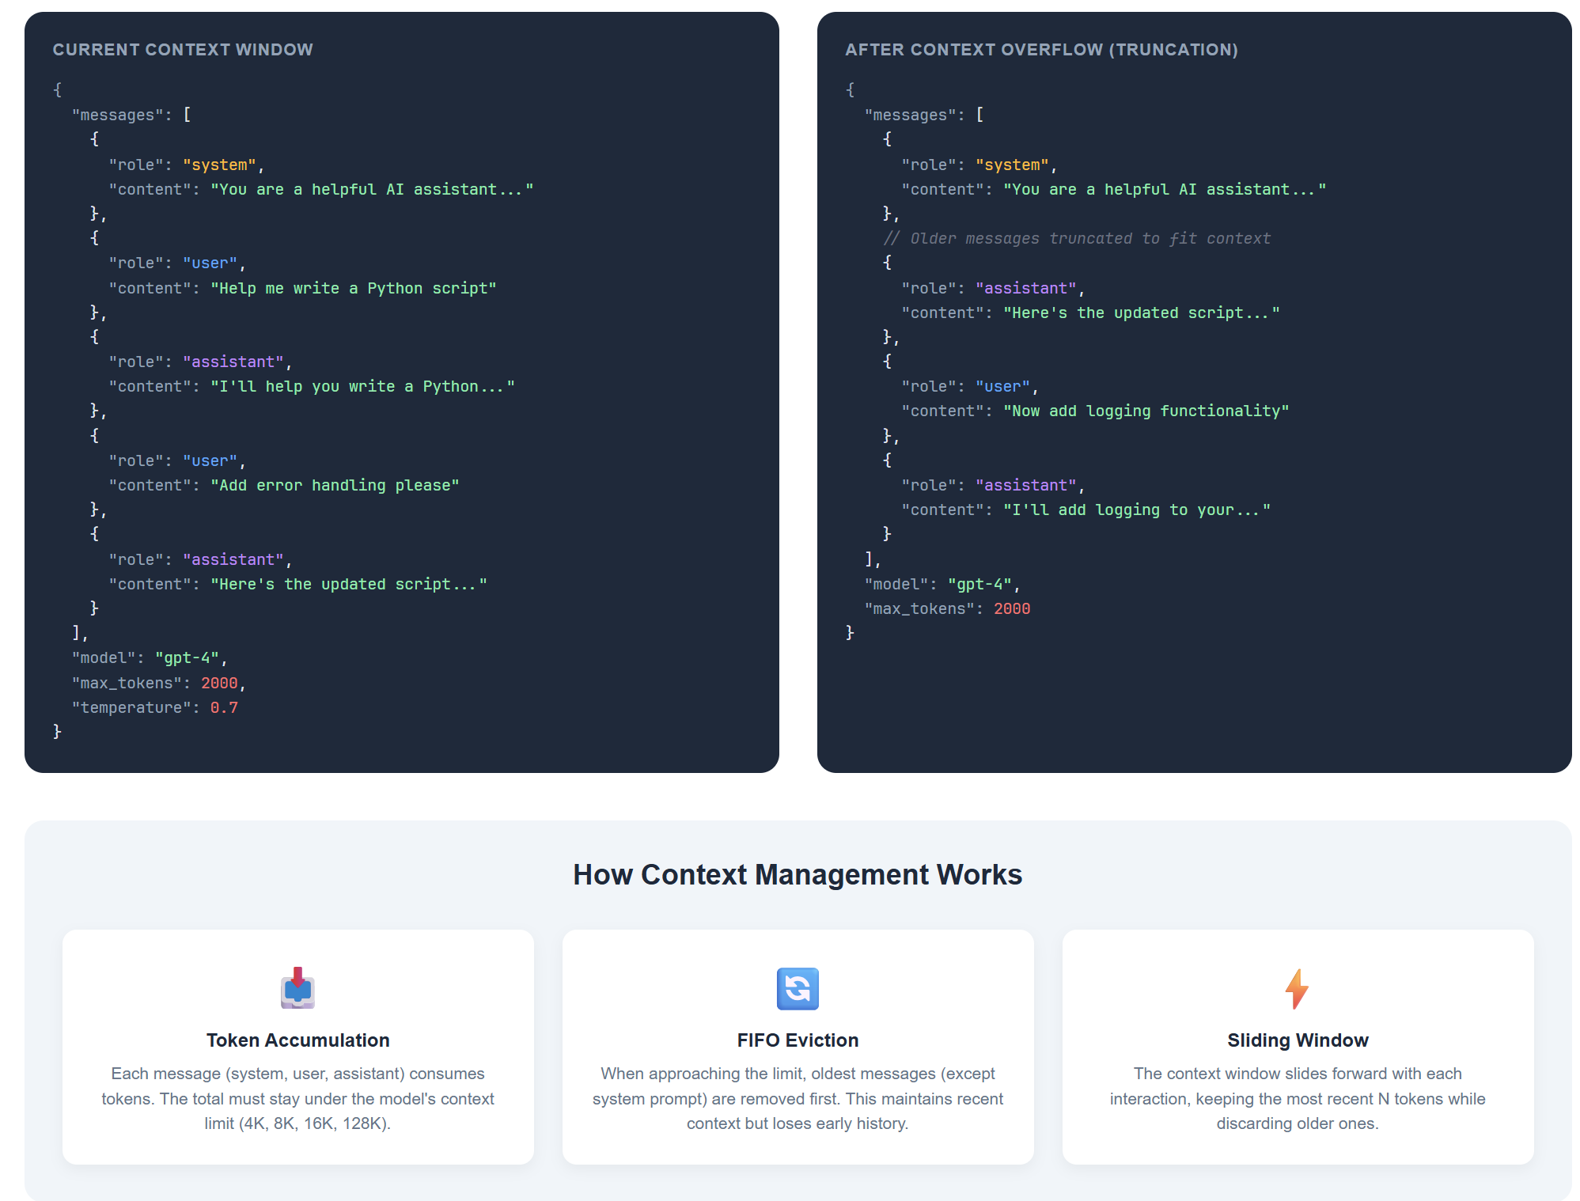

Slide 18
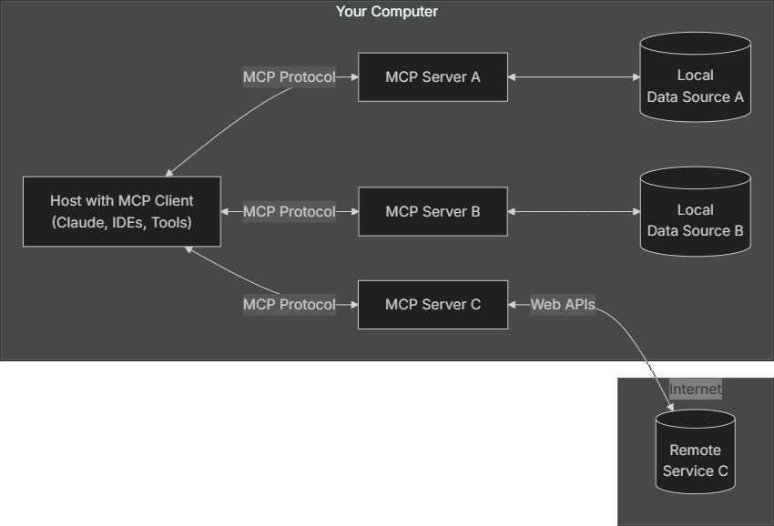
Anthropic Model Context Protocol (MCP)
modelcontextprotocol.io

Slide 19
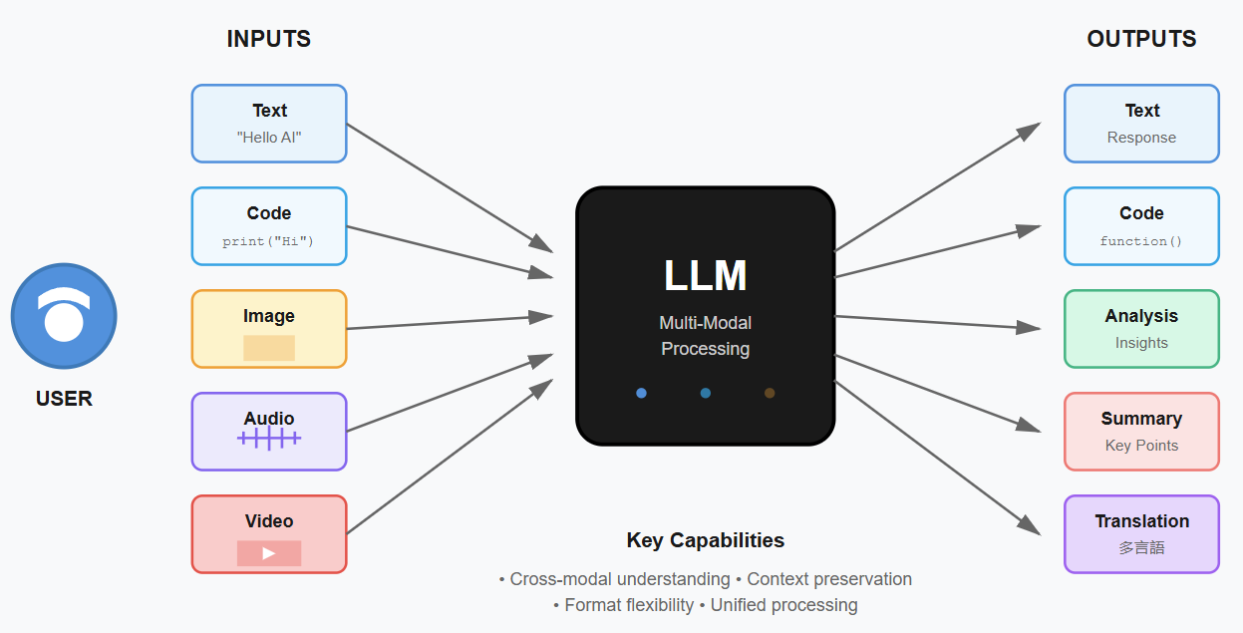
LLM Multi-Modal Processing
Notes:
Image credit: Tim + Claude AI

Slide 20
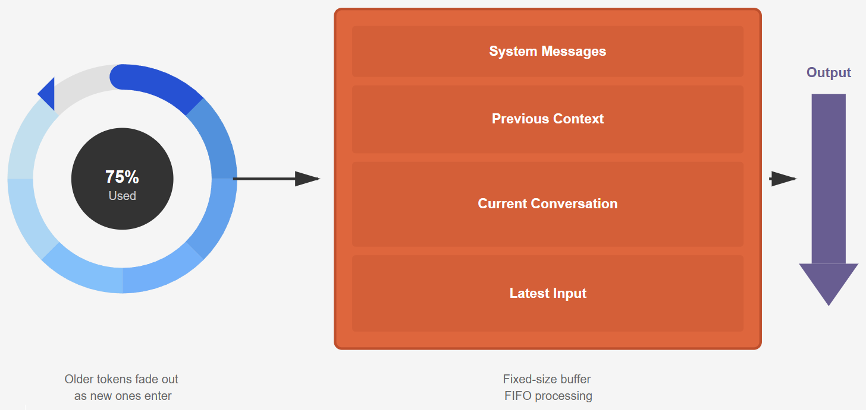
Context Window
Notes:
Illustration credit: Tim

Slide 21
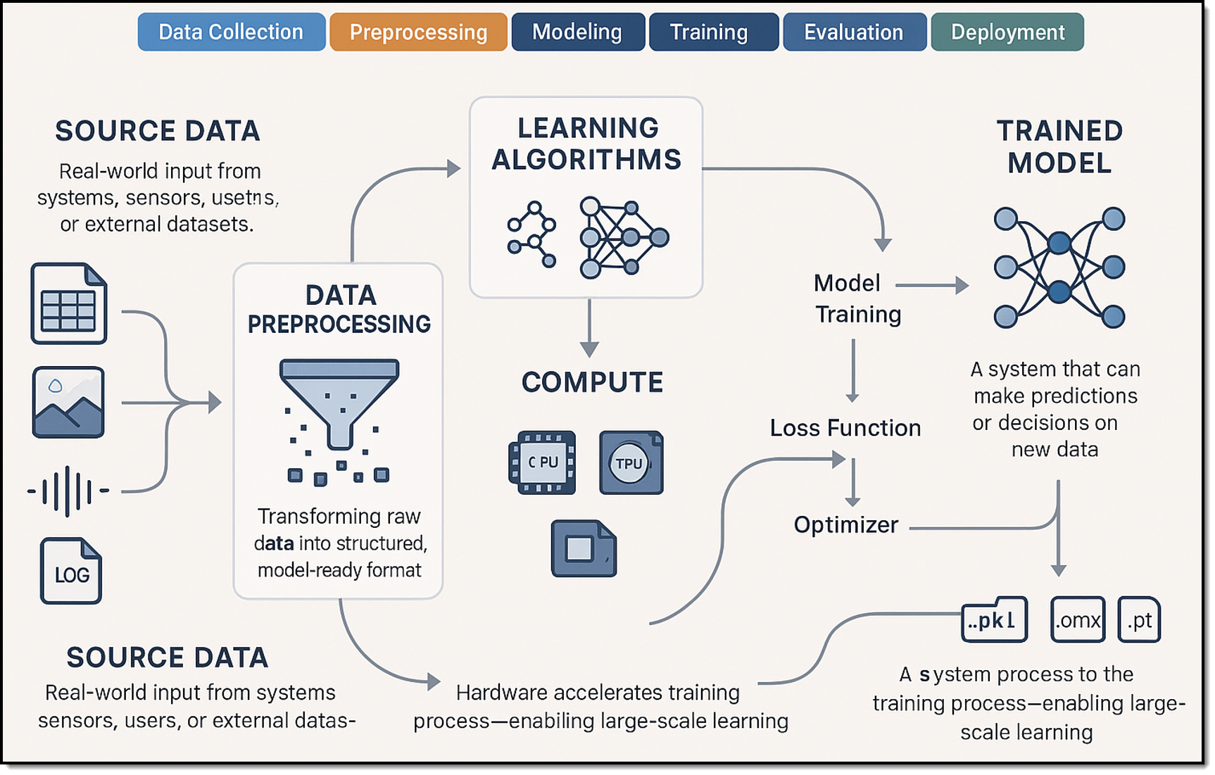
Machine Learning (ML) lifecycle
Notes:
I generated the image with my prompt in my personal ChatGPT account using their latest image-gen model. Did that on Wed, 3/26/2025 at 3pm Central or thereabouts.

Slide 22
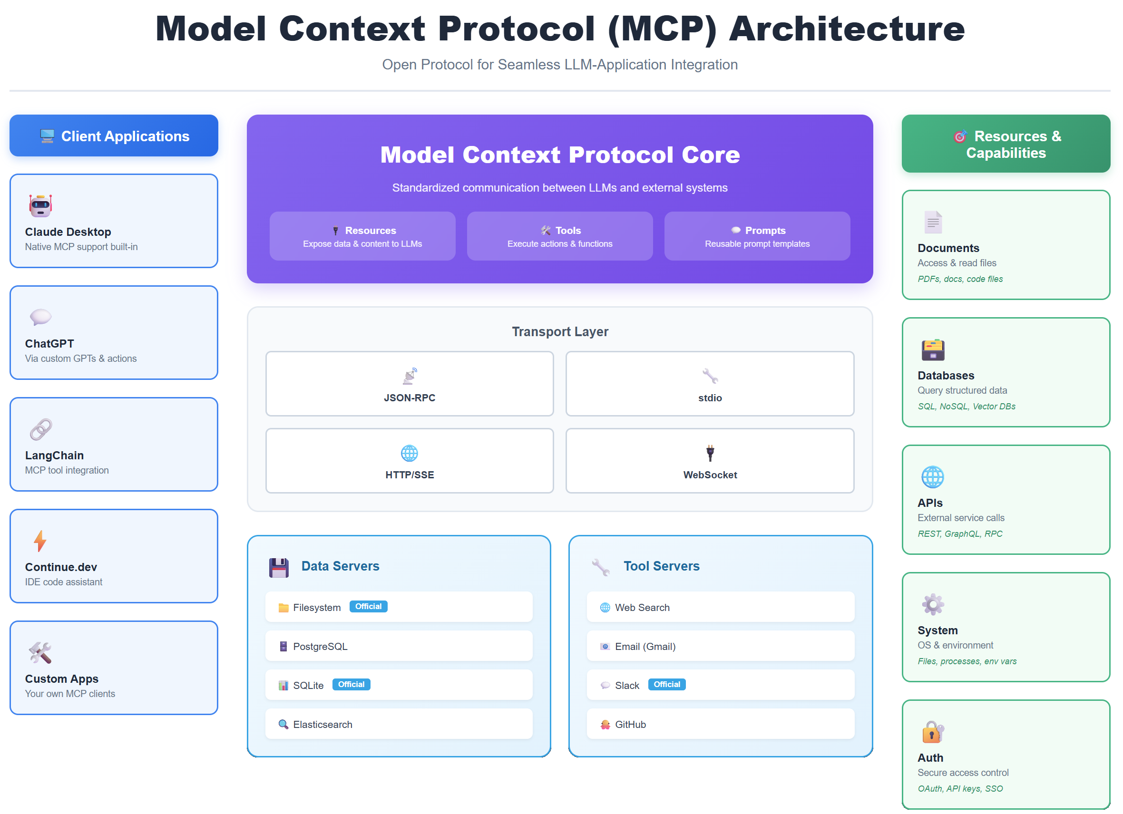

Slide 23
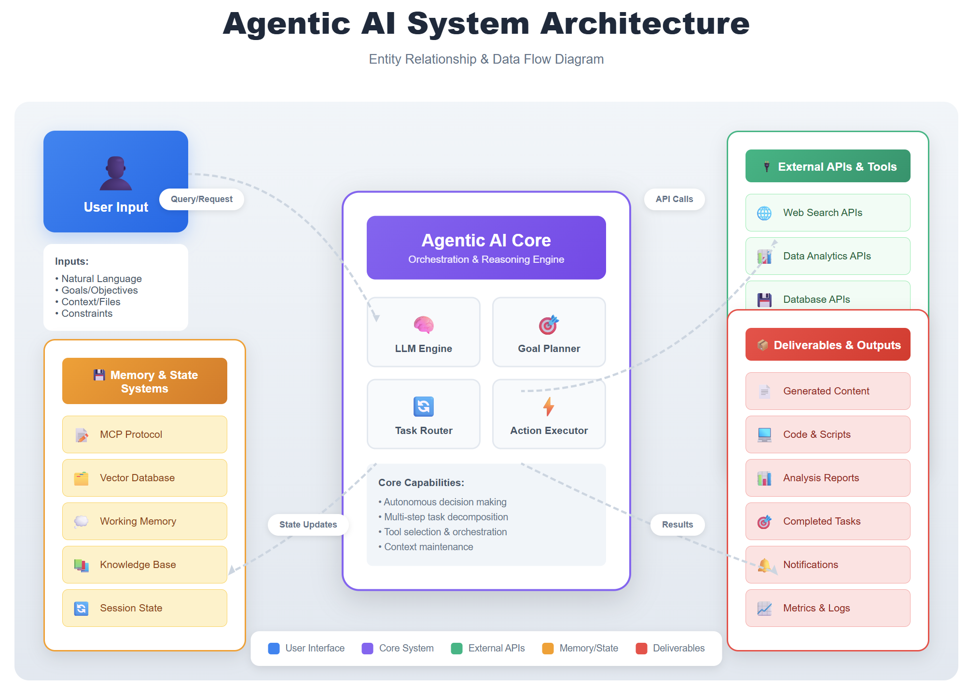

Slide 24
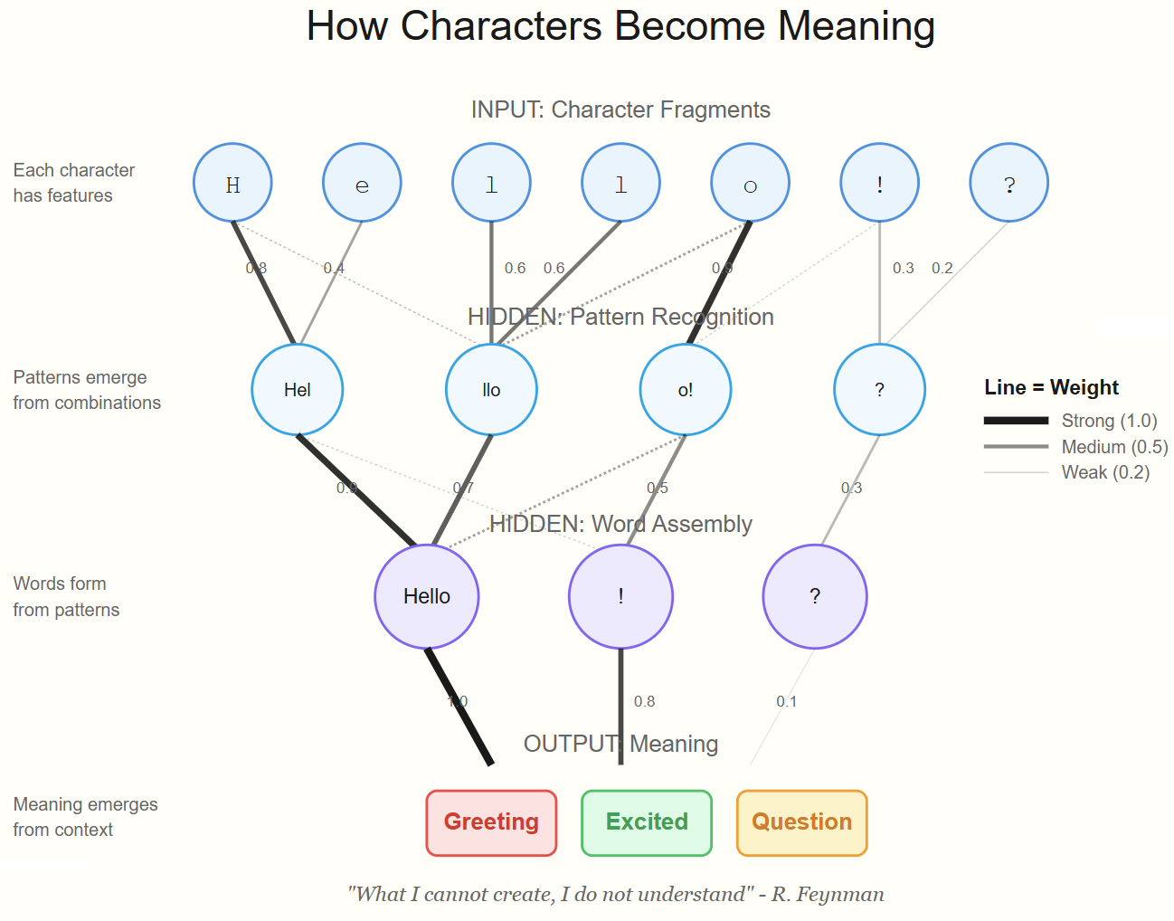
Neural Network
Notes:
Image credit: Tim + Claude AI

Slide 25
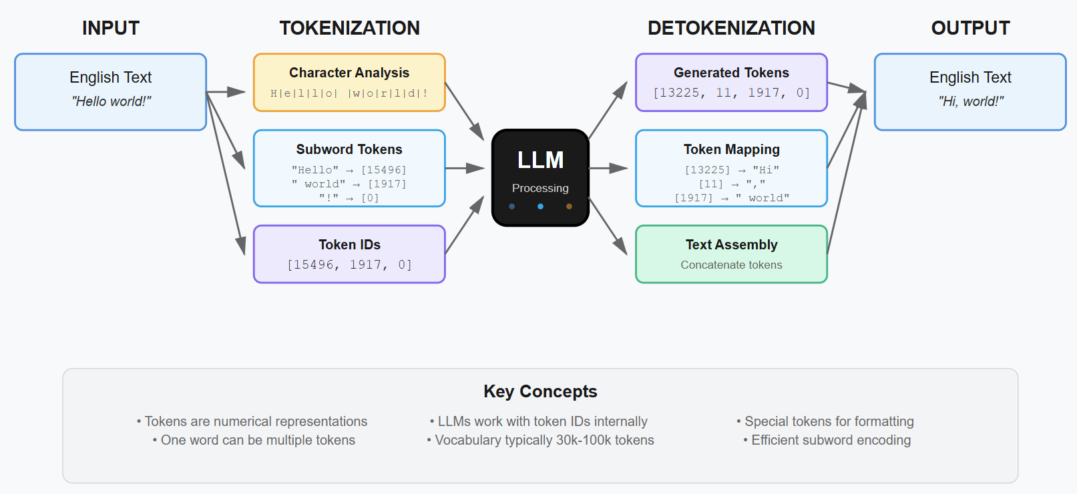
Tokenization Process in LLMs

Slide 26
Thank You for Attending!
Please don’t forget to complete the course eval
Session materials: timw.info/promptpro
Web: techtrainertim.com

